Slide 1
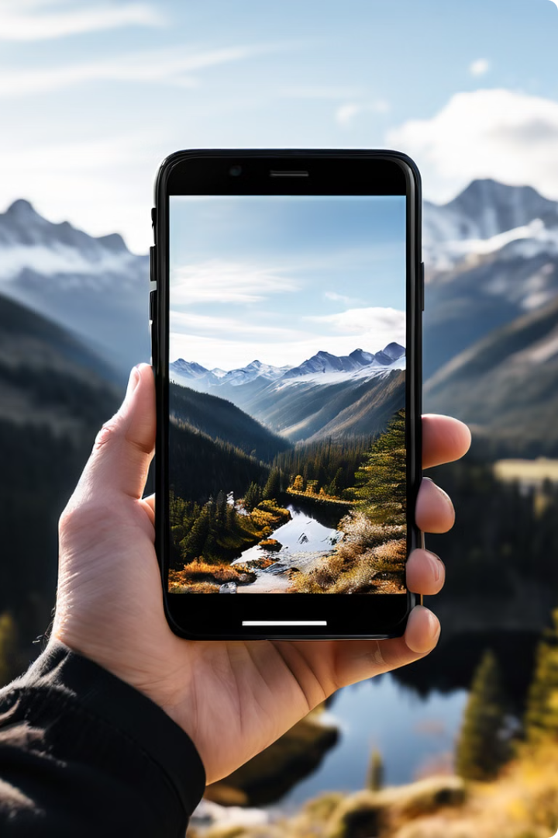
Introduction to Smartphone Videography
Smartphone videography has become increasingly popular, offering convenience, accessibility, and creative opportunities. This presentation will explore the advantages of using a smartphone for video, essential equipment, shooting techniques, and post-production considerations to help you capture stunning footage on the go.
by Matthias Süßen

Slide 2
Advantages of Using a Smartphone for Video
Portability
High-Quality Cameras
Editing Capabilities
Smartphones are compact and lightweight, making them easy to carry and use for on-the-go video capture.
Modern smartphone cameras offer impressive video capabilities, with advanced sensors and computational photography features.
Smartphones provide powerful video editing tools, allowing you to refine your footage directly on the device.

Slide 3
Essential Smartphone Video Equipment
1
External Microphone
2
Tripod or Gimbal
3
Lighting Accessories
Stabilize your shots and create smooth, professional-looking footage with a lightweight tripod or gimbal.
Enhance the visual quality of your videos by using portable LED lights or reflectors to control the lighting.
Improve audio quality by using a dedicated microphone, such as a lavalier or shotgun mic, connected to your smartphone.

Slide 4
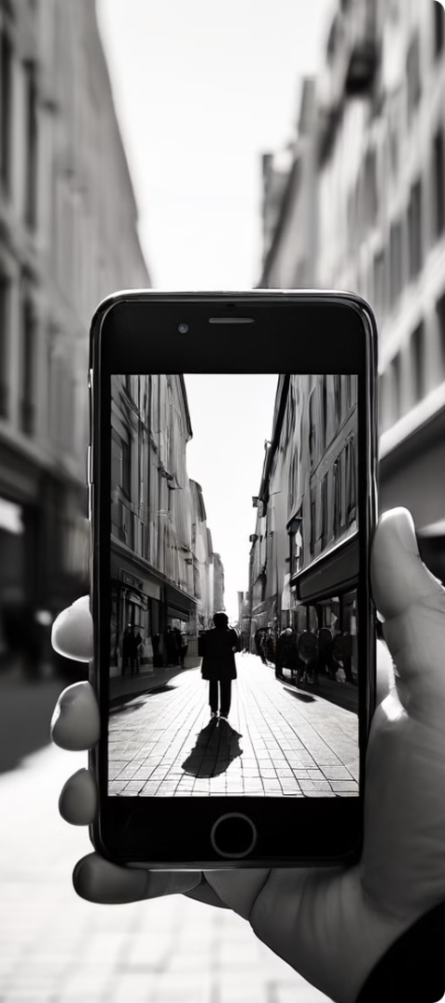
Shooting Techniques for Smartphone Video
Framing and Composition
Camera Movement
Consider the rule of thirds, leading lines, and other compositional guidelines to create visually engaging shots.
Use steady, controlled camera movements, such as panning, tilting, or following a subject, to add dynamism to your videos.
Perspective and Angles
Experiment with different perspectives, such as low-angle or high-angle shots, to enhance the storytelling in your videos.

Slide 5
Lighting and Audio Considerations
Natural Lighting
External Audio
Supplemental Lighting
Utilize natural light from windows or outdoors to achieve a soft, flattering look.
Use a dedicated microphone to capture clear, high-quality sound for your videos.
Consider using portable LED lights or reflectors to improve the overall lighting in your videos.

Slide 6
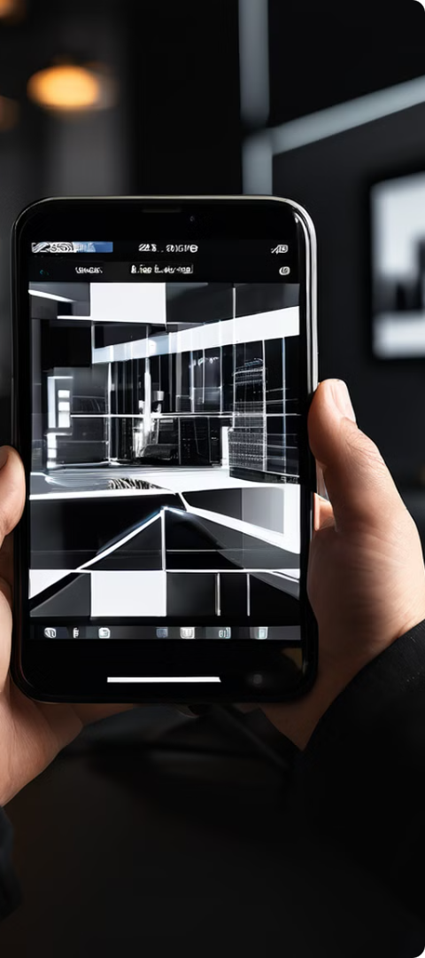
Editing and Post-Production on a Smartphone
1
Trim and Cut
Use built-in editing tools to trim and cut your footage, removing any unwanted segments.
2
Add Effects
Experiment with filters, color grading, and other visual effects to enhance the mood and aesthetics of your videos.
3
Audio Editing
Adjust the volume, add background music, and balance the audio elements to create a polished final product.

Slide 7
Sharing and Distributing Smartphone Videos
Social Media
Easily share your videos on platforms like Instagram, TikTok, and YouTube, reaching a wide audience.
Video Hosting
Upload your videos to dedicated hosting services like Vimeo or your own website for better quality and control.
Messaging
Share short, engaging clips directly with friends and family through messaging apps or email.

Slide 8
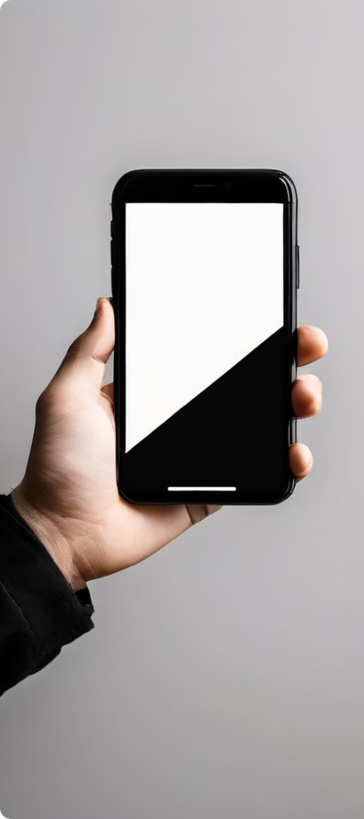
Conclusion and Next Steps
Keep Practicing
Consistently practice your smartphone videography skills to improve and develop your unique style.
Explore More
Experiment with advanced techniques, such as cinematic framing, video essays, or stop-motion animation.
Share Your Work
Proudly share your smartphone videos with others and engage with the growing community of mobile filmmakers.

